Slide 1
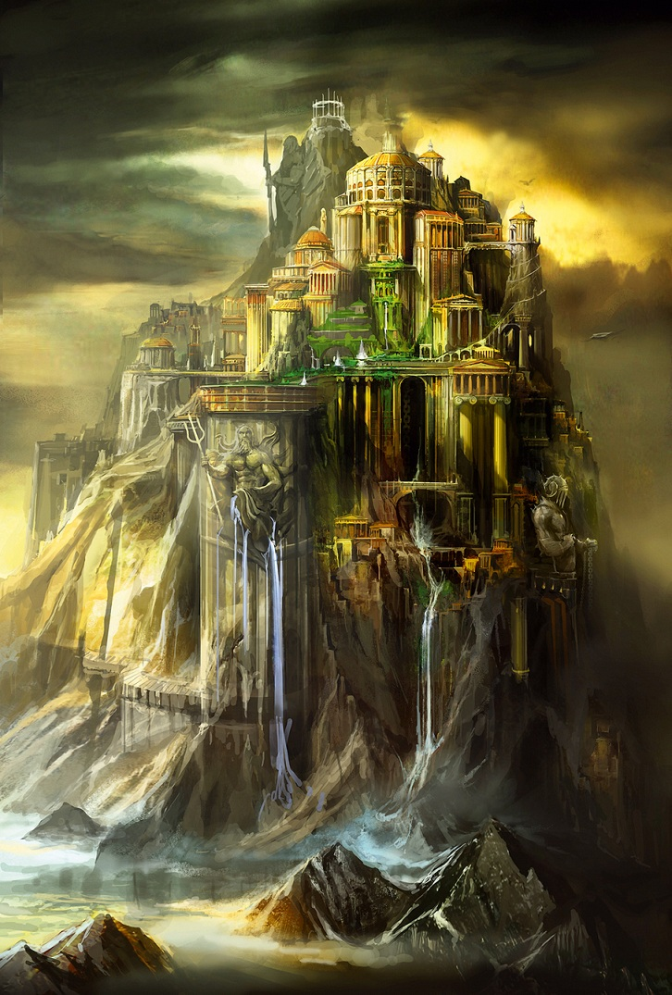
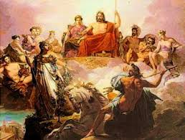
Meet the Gods

Slide 2
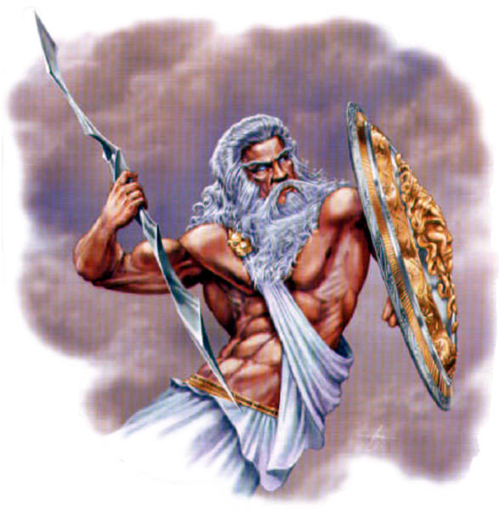
Zeus
The top god, son of the Titan Kronos. God of the sky and lightning. Frequently appears in disguise.
Symbol: eagle.
Weapon: lightning bolt.

Slide 3
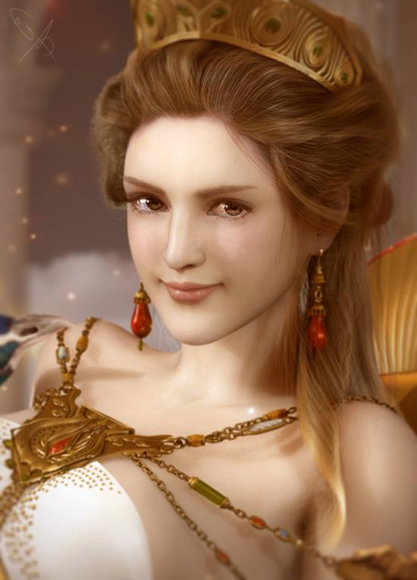
Hera
Daughter of Kronos and rhea, and wife to Zeus. Goddess of marriage and motherhood.
Symbol: Cow, lion, peacock.

Slide 4
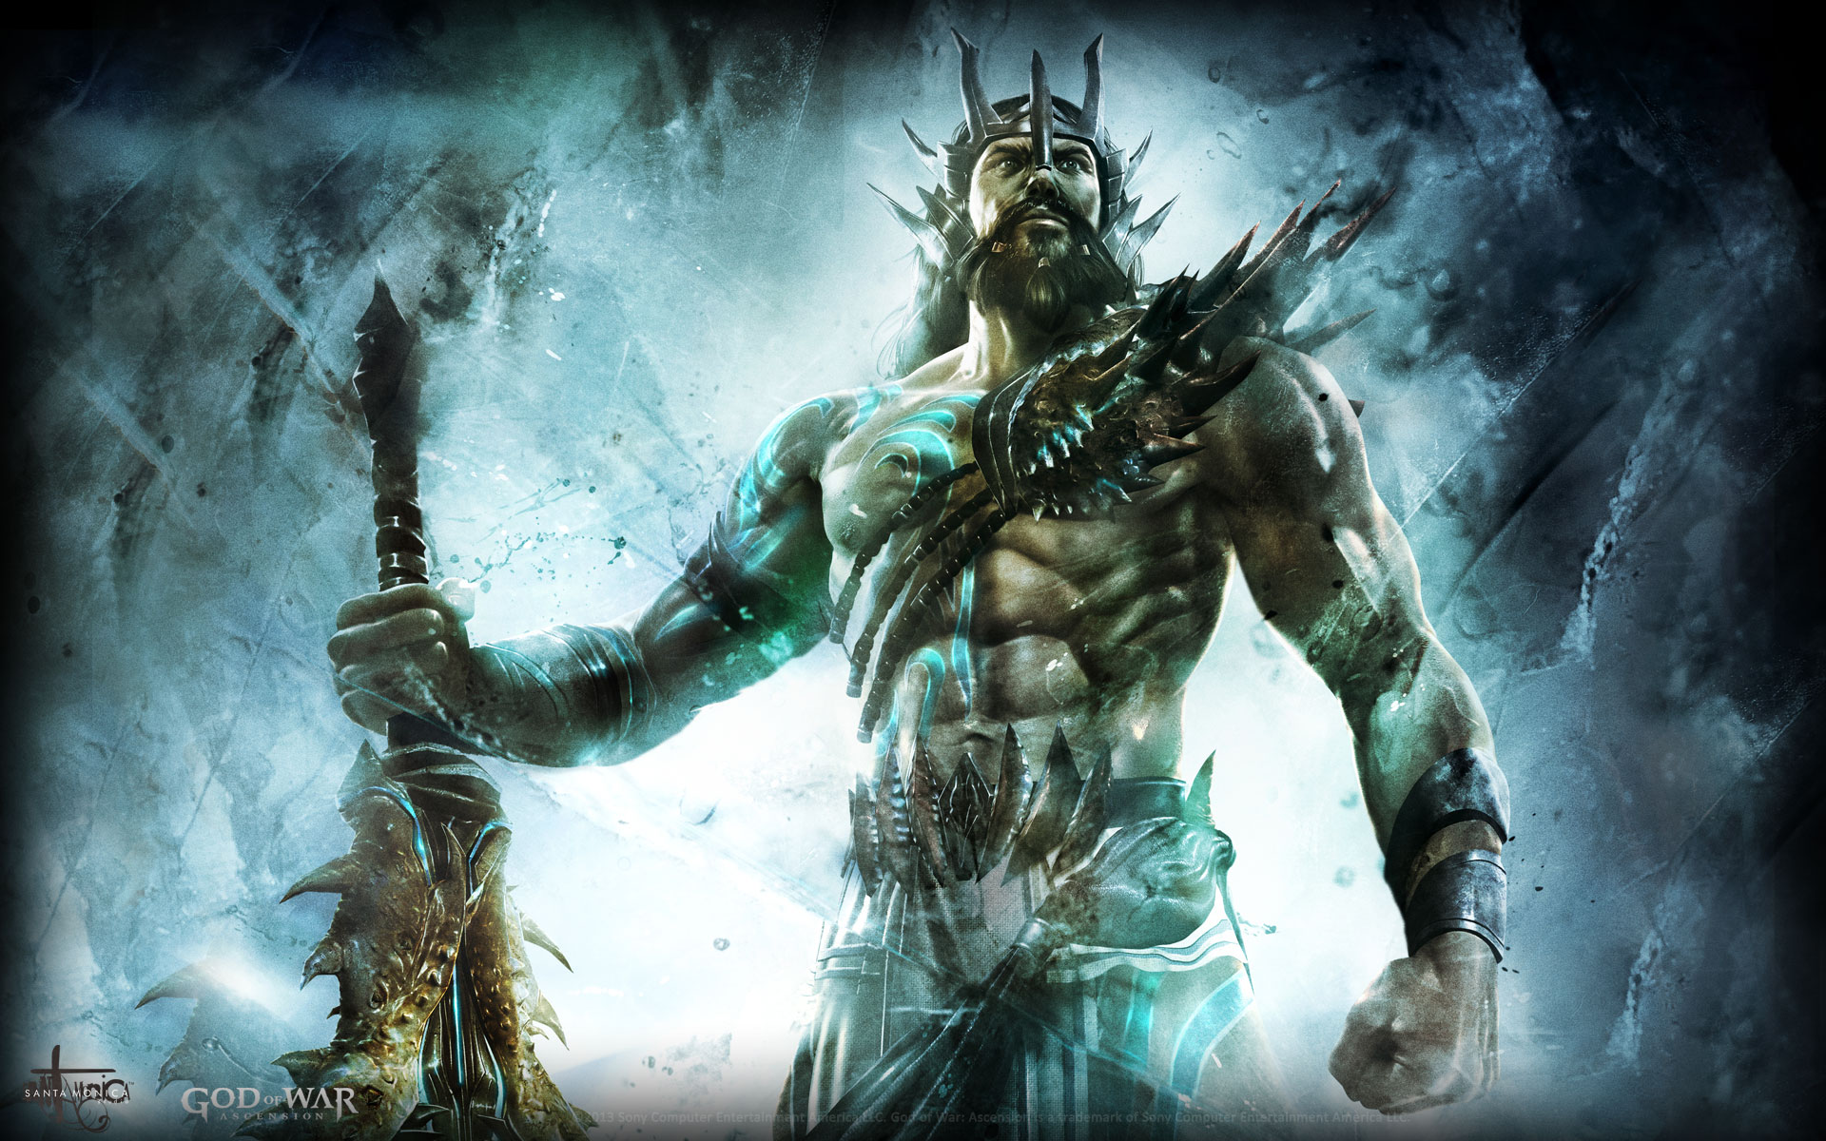
Poseidon
God of the sea, son of the Titan Kronos, and father of Percy Jackson. like the sea, can be violent or calm and swiftly change between the two.
Symbol: horse, which he creates from sea foam.
Weapon: Trident, which he uses to stir up storms at sea.

Slide 5
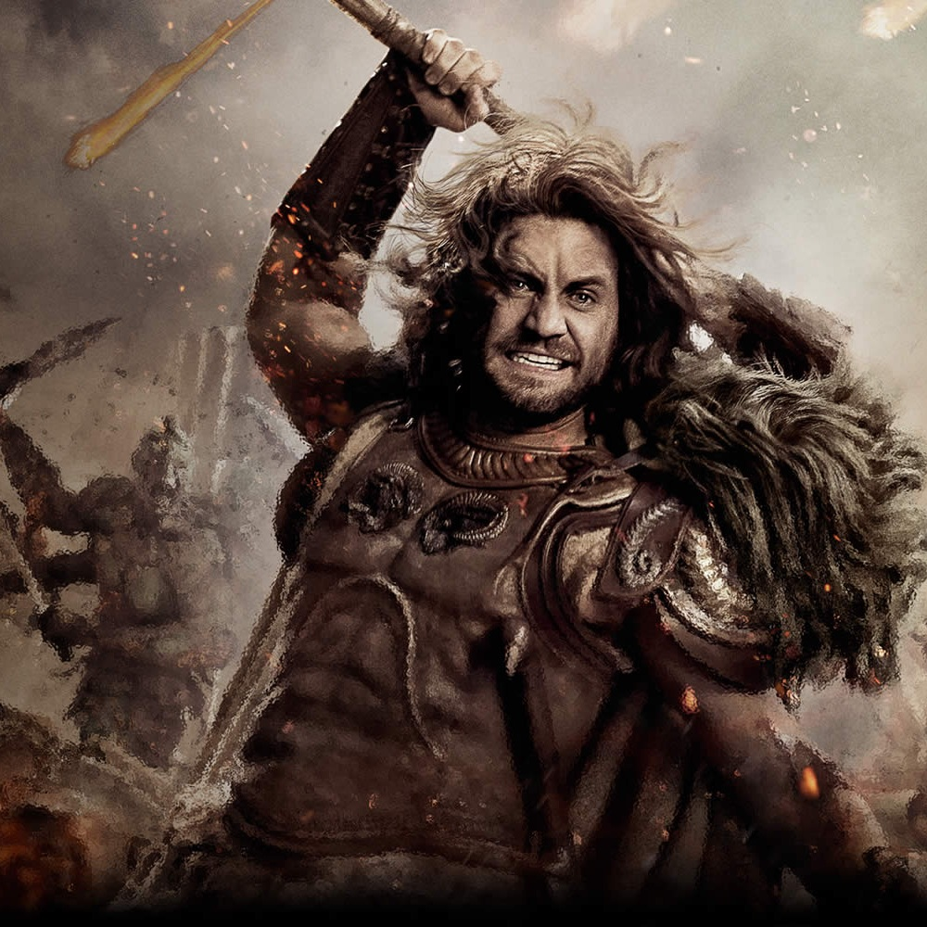
Ares
God of war, and son of Zeus and hera.
Symbol: Wild boar.
Weapon: Bloody spear. often pictured in a chariot with a sword and shield.

Slide 6
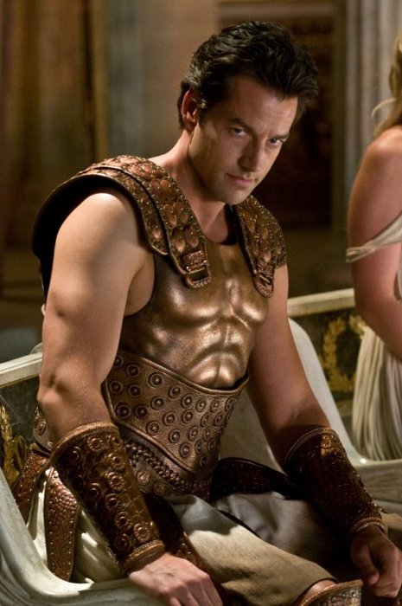
Apollo
Twin brother of Artemis. God of healing (and disease), music, poetry and prophecy.
Symbols: The lyre, the laurel tree, the serpent, the mouse.
Weapon: Bow and arrows. Can infect men and boys with plague or cause sudden death.
Has the gift of prophecy which he can give to others.

Slide 7
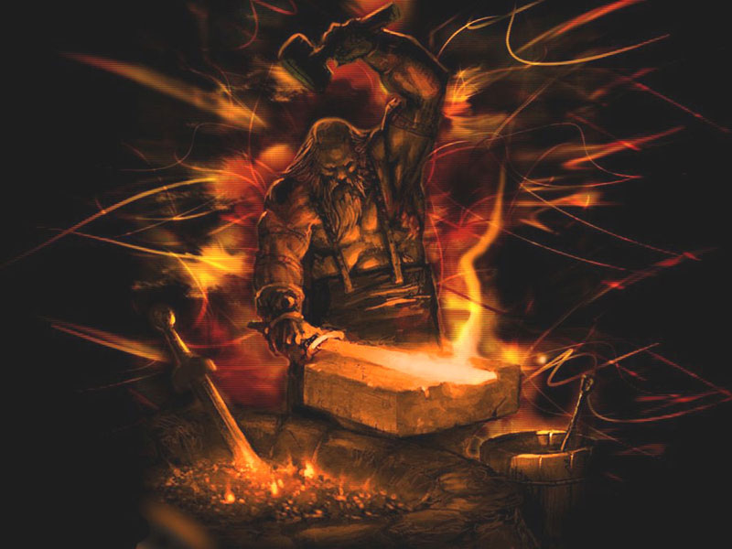
Hephaestus
The blacksmith of the gods, married to Aphrodite. God of fire, metalwork and sculpture.
Symbol: anvil, quail (which walks like him).
Weapon: Makes armor that makes the wearer impossible to defeat.

Slide 8
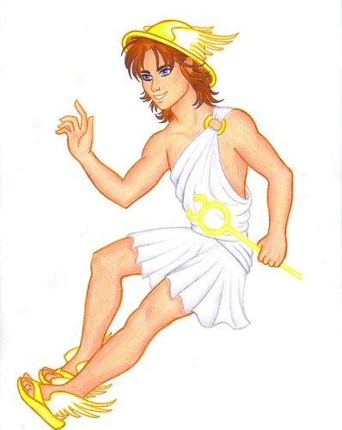
Hermes
Messenger of the gods, and god of travel, merchants, medicine, thieves, roads, communication and language.
Symbol: Winged boots and helmet to help him travel at speed. Carries a staff entwined with a serpent, the symbol of medicine today.
Weapon: Trickery and deceit.

Slide 9
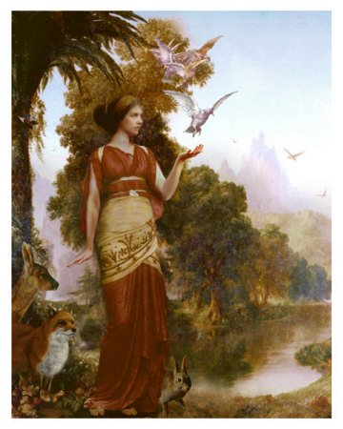
Demeter
Goddess of agriculture, controlling the seasons.
Symbol: red poppy, barley

Slide 10
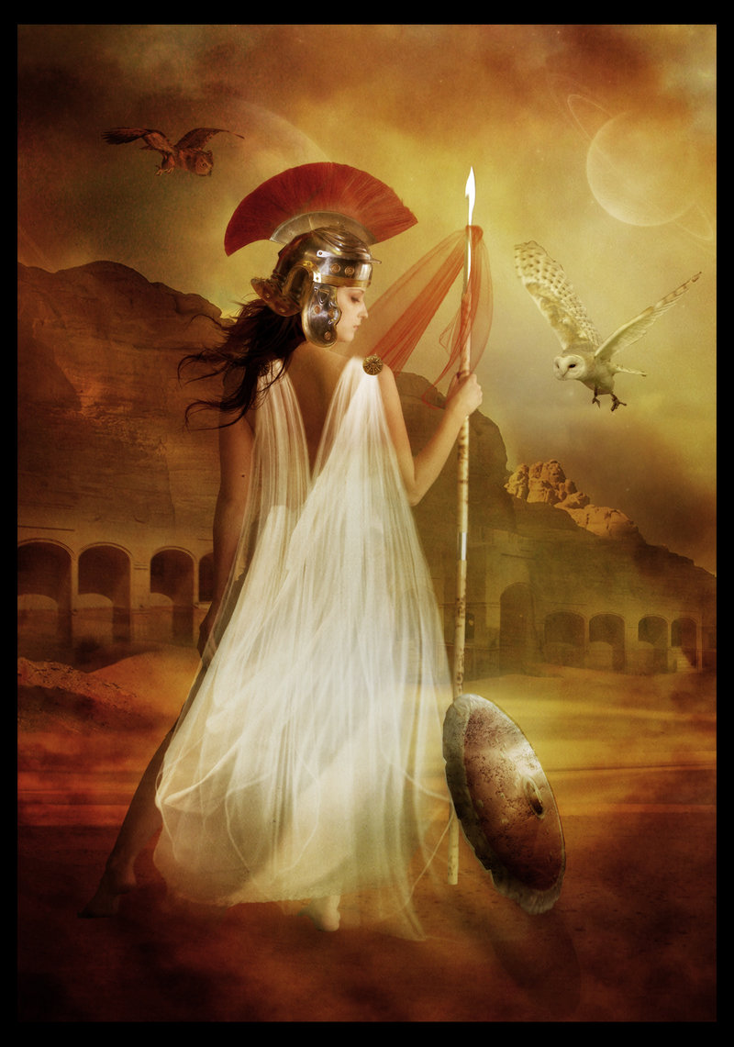
Athena
Born fully grown from Zeus’s head. Goddess of wisdom, military planning, crafts and inventions.
Symbol: owl, the olive tree
Weapon: Can influence the outcome of battles. helped the Greeks to build the wooden horse that defeated Troy after ten years of fighting. Punishes those who try to compete with her

Slide 11
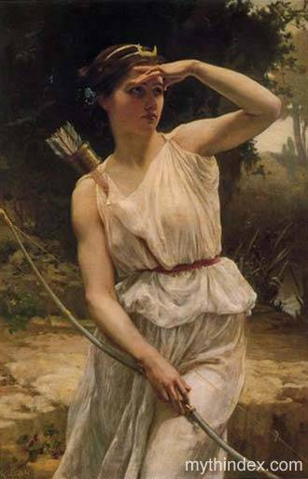
Artemis
Twin sister of Apollo. Goddess of hunting, wild animals and protector of young women and girls.
Symbol: Deer, Bear.
Weapon: Bow and arrows. Can infect women and girls with plague or cause sudden death.

Slide 12
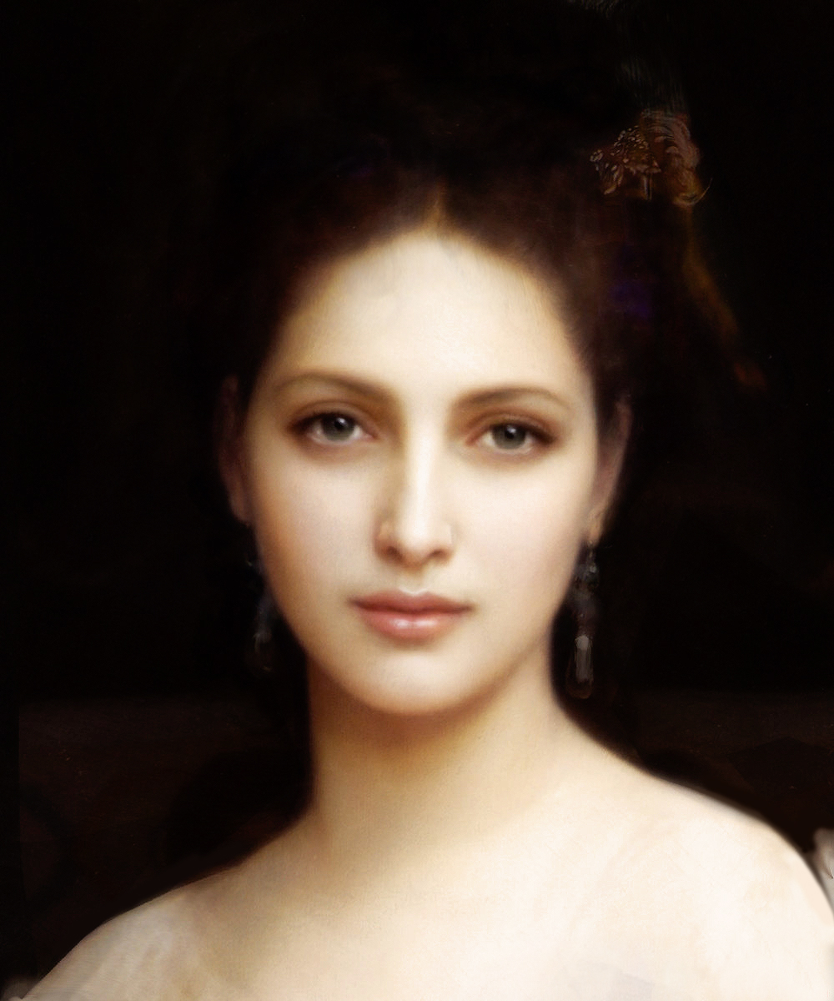
Aphrodite
The goddess of love and beauty, born from sea foam.
Symbol: dove, apple, scallop shell, mirror, the color pink.
Weapon: Can use her magic girdle to make men fall in love with her.

Slide 13
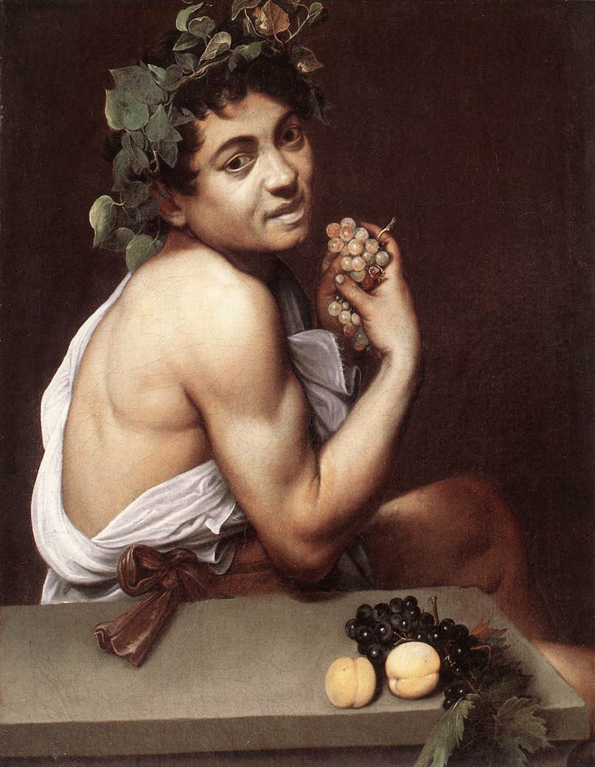
Dionysus
Born a mortal, but Zeus granted him immortality because he invented wine. his companions are the satyrs.
Symbol: Tiger, grapes

Slide 14
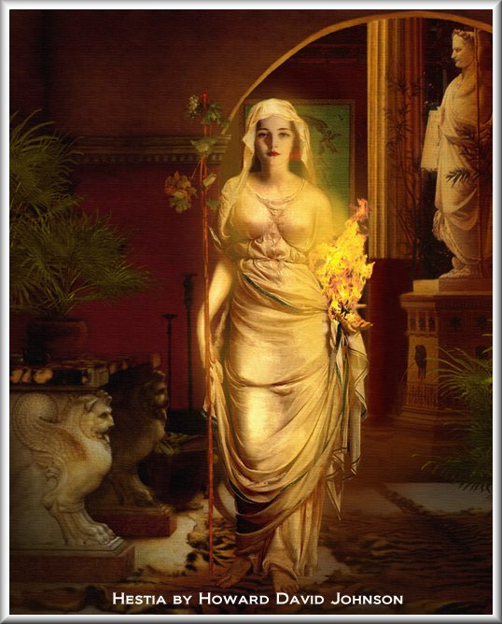
Hestia
Hestia is the goddess of the home and hearth and the goddess of the flame.
Symbols: Hearth, Kettle

