Slide 1
Greek Mythology
The Creatures

Slide 2
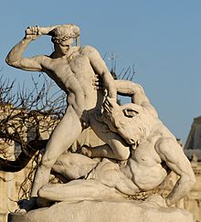
1: Minotaur
Monster with the head of a bull and the body of a man

Slide 3
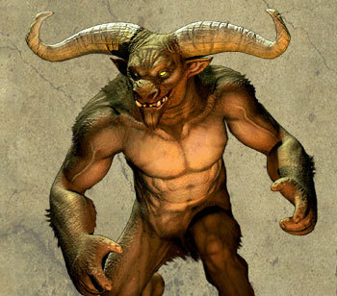

Slide 4
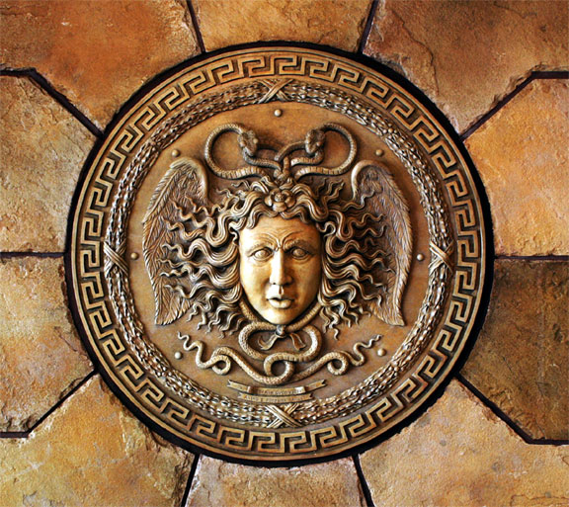
Gorgons
Monstrous sisters with wings of gold, brazen claws and serpents for hair
Have the ability to turn men to stone with their gaze.
Euryale
Medusa
Stheno

Slide 5
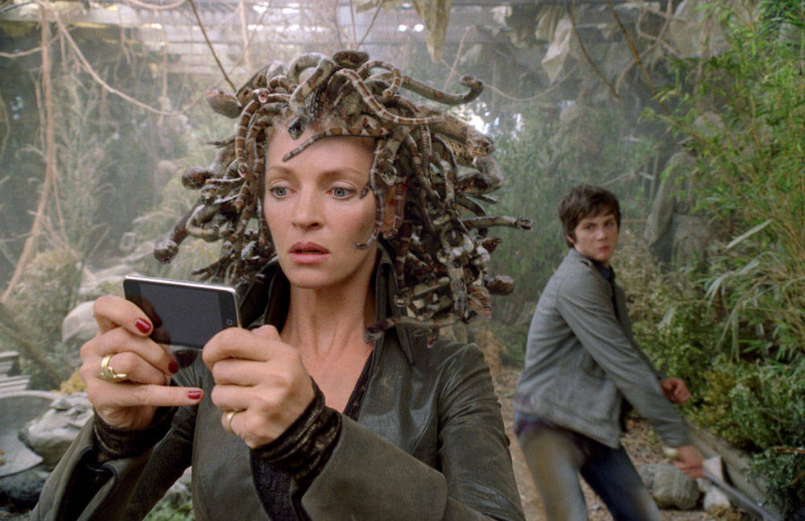

Slide 6
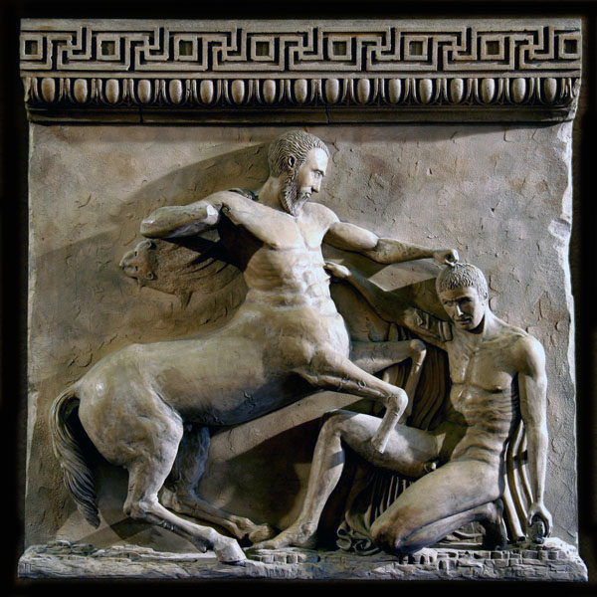
Centaurs
Race of half-man, half-horse beings
Chiron (the eldest and wisest centaur)
Nessus (Ferryman of the River Euenus
Chariclo (wife of Chiron)

Slide 7
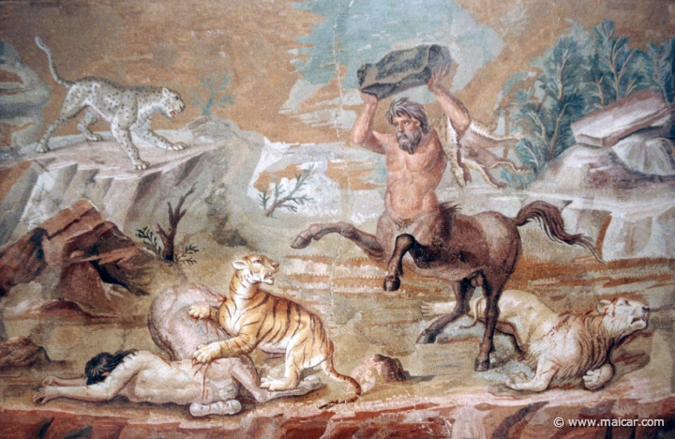

Slide 8
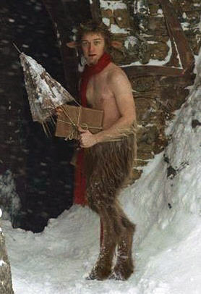
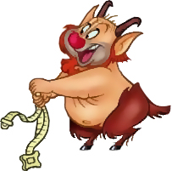
Satyrs
Nature-spirits with the upper-bodies of men and the lower body of a goat

Slide 9
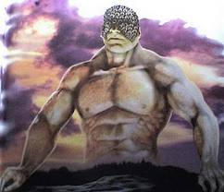
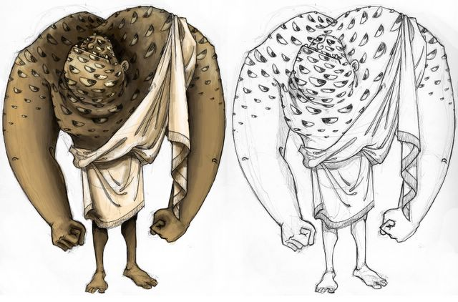
Argus
100 eyed giant

Slide 10
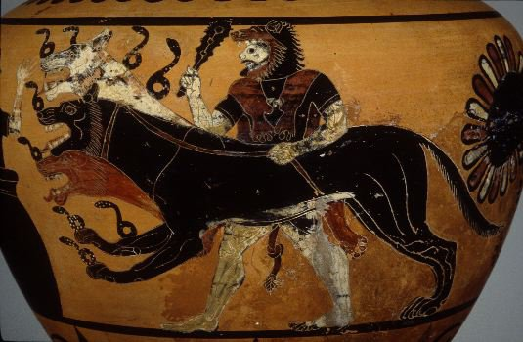
Cerberus
Three-headed, giant hound. Guards the mouth of Hades

Slide 11
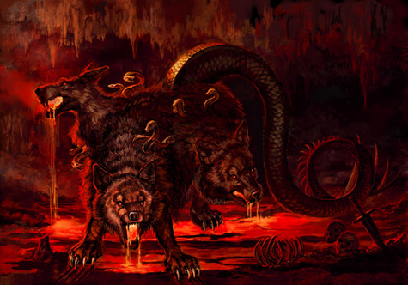
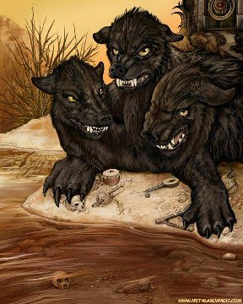
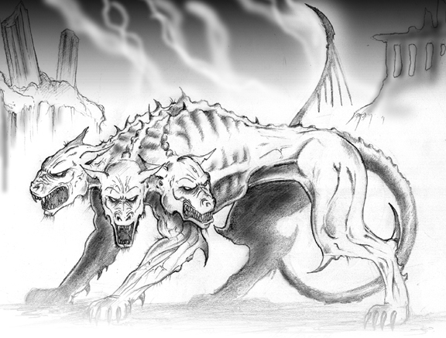

Slide 12
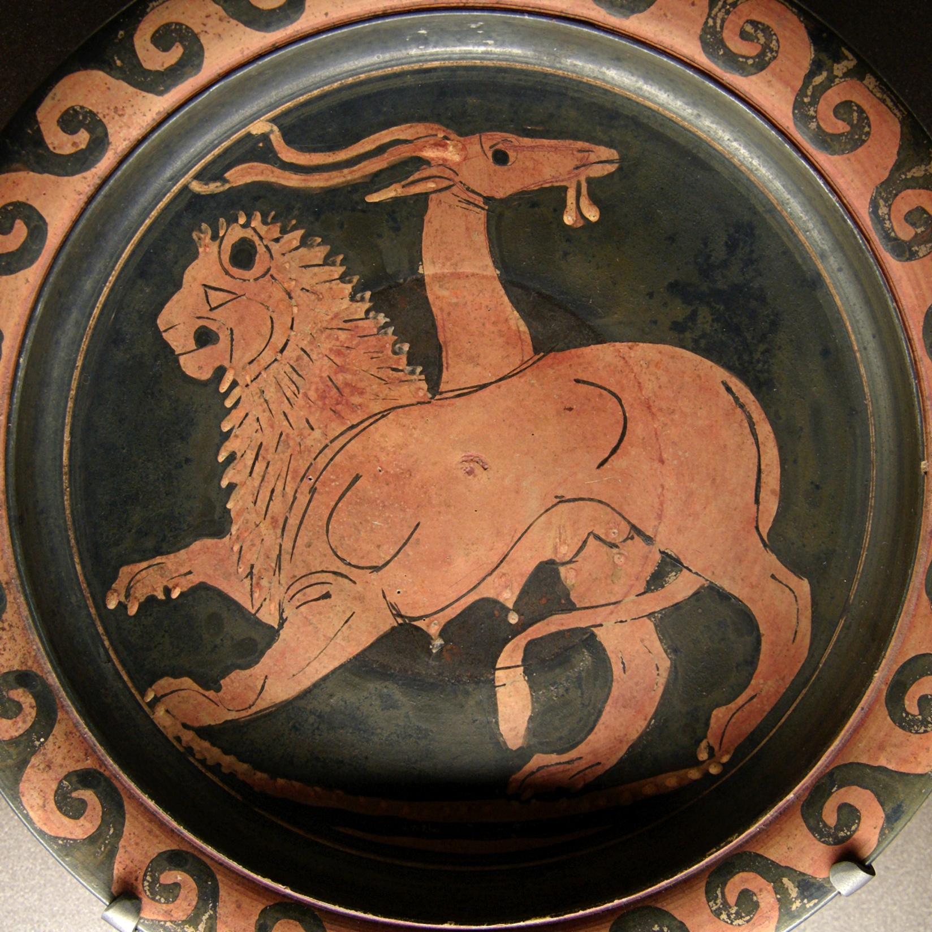
Chimera
A three-headed monster, with the foreparts of a lion, the hind-parts of a goat.
Goats head rising from its back and tail of a headed serpent

Slide 13
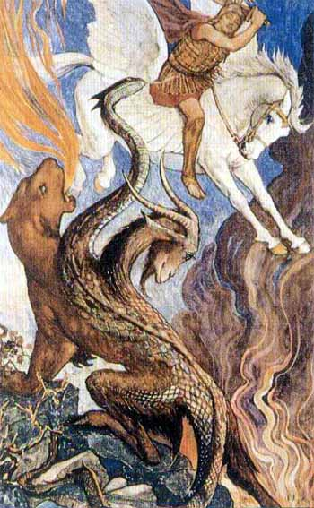
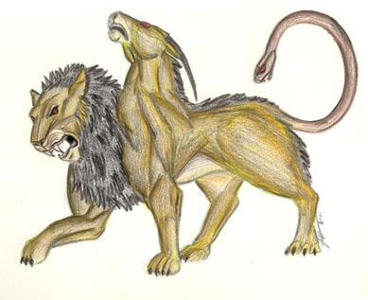

Slide 14
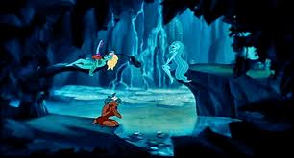
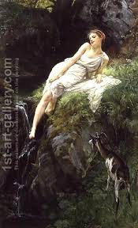
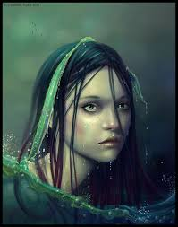
Nymphs
Female nature deity (god) associated with particular landforms or locations (celestial, land, plant, water, and underworld)

Slide 15
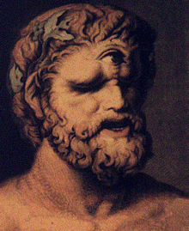
Cyclopes
Three one-eyed giants

